Slide 1
IDS561 Big Data Analytics
Yuheng Hu

Slide 2
HDFS architecture recap
namenode
job submission node
namenode daemon
jobtracker
tasktracker
tasktracker
tasktracker
datanode daemon
datanode daemon
datanode daemon
Linux file system
Linux file system
Linux file system
…
…
…
slave node
slave node
slave node
One of each:
Namenode (NN): master node for HDFS
Jobtracker (JT): master node for job submission
Set of each per slave machine:
Tasktracker (TT): contains multiple task slots
Datanode (DN): serves HDFS data blocks

Slide 3
How Does Hadoop work in practice?

Slide 6
The Map-Reduce Appeal
Scalable due to simpler design
Only parallelizable operations
No transactions
Scale
$
Runs on cheap commodity hardware

Slide 7
Disadvantages
1. Extremely rigid data flow
M
R
Other flows constantly hacked in
M
M
R
M
Join, Union
Split
Chains
2. Common operations must be coded by hand
Join, filter, projection, aggregates, sorting, distinct
3. Semantics hidden inside map-reduce functions
Difficult to maintain, extend, and optimize

Slide 8
Pros and Cons of MapReduce
Inflexible
Lots of hand coding
Scalable
Cheap
Control over execution
Semantics hidden
Need a high-level, general data flow language

Slide 9
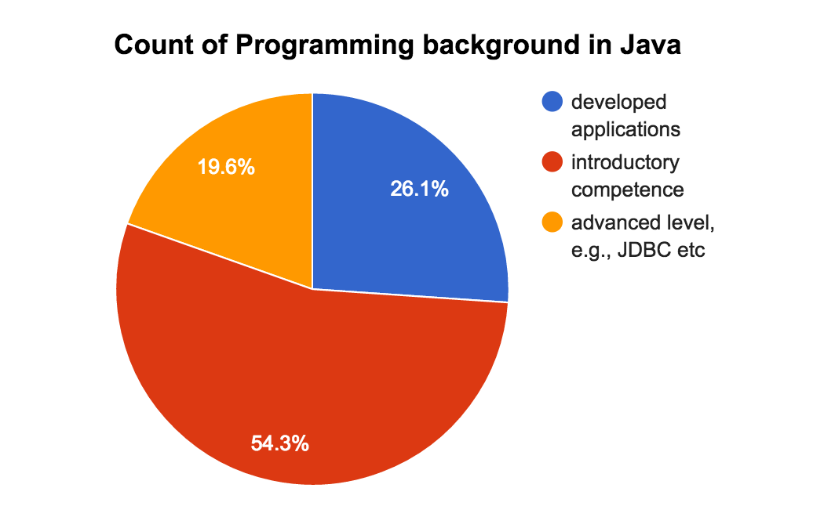
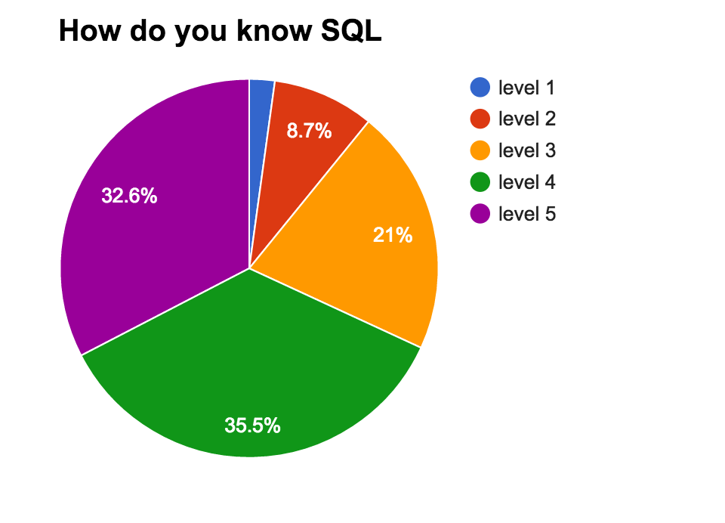
Java vs. SQL
Not everyone wants to (or can) write Java code ☺

Slide 10


Hive and Pig
Hive: data warehousing application in Hadoop
Query language is HQL, variant of SQL
Tables stored on HDFS as flat files
Developed by Facebook, now open source
Pig: large-scale data processing system
Scripts are written in Pig Latin, a dataflow language
Developed by Yahoo!, now open source
Roughly 1/3 of all Yahoo! internal jobs
Common idea:
Provide higher-level language to facilitate large-data processing
Higher-level language “compiles down” to Hadoop jobs

Slide 11
Motivation of HIVE
Problem : Data, data and more data
Prior to 2008, data processing at FB was built around a data warehouse built using a commercial RDBMS.
Several TBs of data everyday, some daily data processing jobs were taking more than a day
The Hadoop Experiment:
Uses Hadoop File System (HDFS)
Scalable/Available
Problem
Lacked Expressiveness
Map-Reduce hard to program
Solution : HIVE

Slide 12
Combine SQL and Map-Reduce
Map-Reduce is scalable, so uses Map-Reduce for execution
HDFS for Storage
SQL has a huge user base
SQL is easy to code
A database/data warehouse on top of Hadoop
Rich data types (structs, lists and maps)
Efficient implementations of SQL filters, joins and group-by’s on top of map reduce

Slide 13

Hive Usage @ Facebook
Statistics per day:
4 TB of compressed new data added per day
135TB of compressed data scanned per day
7500+ Hive jobs on per day
Hive simplifies Hadoop:
~200 people/month run jobs on Hadoop/Hive
Analysts (non-engineers) use Hadoop through Hive
95% of jobs are Hive Jobs
http://www.slideshare.net/cloudera/hw09-hadoop-development-at-facebook-hive-and-hdfs

Slide 14
Type System in HIVE
Primitive types
Integers:TINYINT, SMALLINT, INT, BIGINT.
Boolean: BOOLEAN.
Floating point numbers: FLOAT, DOUBLE .
String: STRING.
Complex types
Structs: {a INT; b INT}.
Maps: M['group'].
Arrays: ['a', 'b', 'c'], A[1] returns 'b'.

Slide 15
Data Model
Tables
Typed columns (int, float, string, boolean)
Also, list: map (for JSON-like data)
Partitions
For example, range-partition tables by date
Buckets
Hash partitions within ranges (useful for sampling, join optimization)
Source: cc-licensed slide by Cloudera

Slide 16
Data Model - Tables
Tables
Analogous to tables in relational DBs.
Each table has corresponding directory in HDFS,
Example:
Create a table in Hive
Create Table records(yr string, temp int)
row format Delimited Fields Terminated by ‘\t’
Populate Hive with the data
Load Data Local Inpath ‘input/sample.txt’
Overwrite into Table records;
Hive moves data to its corresponding directory in HDFS
% ls /user/hive/warehouse/records/
sample.txt

Slide 17
Data Model - Partitions
Partitions
Analogous to indexes on partition columns
A file with pairs of keys and pointers for every record in the data file. Every key in this file is associated with a particular pointer to a record in the sorted data file
Nested sub-directories in HDFS for each combination of partition column values.
Allows users to efficiently retrieve rows
Example
Partition columns: ds, ctry
HDFS for ds=20120410, ctry=US
/wh/pvs/
ds=20120410/
ctry=US
File1
File2
ds=20120410/
ctry=IN
File1
File2

Slide 18
Partitioning - Contd..
Partitioning – Creating partitions
CREATE TABLE Logs(id string, hr int)
PARTITIONED BY (ds string, ctry string);
Load data
LOAD DATA LOCAL INPATH ‘input/partition/files1’
INTO TABLE Logs
PARTITION (ds=‘20120410’, ctry=‘US’)

Slide 19
Partitioning - Contd..
SELECT * FROM test_part WHERE ds='2009-01-01';
will only scan all the files within the
/user/hive/warehouse/test_part/ds=2009-01-01 directory
SELECT * FROM test_part
WHERE ds='2009-02-02' AND hr=11;
will only scan all the files within the /user/hive/warehouse/test_part/ds=2009-02-02/hr=11 directory.

Slide 20
Data Model - buckets
Buckets
Split data based on hash of a column – mainly for parallelism
Data in each partition may in turn be divided into Buckets based on the value of a hash function of some column of a table.
Example
Bucket column: user into 32 buckets
HDFS file for user hash 0
/wh/pvs/ds=20120410/cntr=US/part-00000
HDFS file for user hash bucket 20
/wh/pvs/ds=20120410/cntr=US/part-00020

Slide 21
Physical Layout of Hive - Summary
Warehouse directory in HDFS
E.g., /user/hive/warehouse
Tables stored in subdirectories of warehouse
Partitions form subdirectories of tables
Actual data stored in flat files
Control char-delimited text, or SequenceFiles
Source: cc-licensed slide by Cloudera

Slide 22
HiveQL: Example
HiveQL looks similar to an SQL database
Relational join on two tables:
Table of word counts from Shakespeare collection
Table of word counts from the bible
SELECT s.word, s.freq, k.freq FROM shakespeare s
JOIN bible k ON (s.word = k.word) WHERE s.freq >= 1 AND k.freq >= 1 ORDER BY s.freq DESC LIMIT 10;
the 25848 62394
I 23031 8854
and 19671 38985
to 18038 13526
of 16700 34654
a 14170 8057
you 12702 2720
my 11297 4135

Slide 23
HiveQL: Behind the Scenes
SELECT s.word, s.freq, k.freq FROM shakespeare s
JOIN bible k ON (s.word = k.word) WHERE s.freq >= 1 AND k.freq >= 1 ORDER BY s.freq DESC LIMIT 10;
(Abstract Syntax Tree)
(TOK_QUERY (TOK_FROM (TOK_JOIN (TOK_TABREF shakespeare s) (TOK_TABREF bible k) (= (. (TOK_TABLE_OR_COL s) word) (. (TOK_TABLE_OR_COL k) word)))) (TOK_INSERT (TOK_DESTINATION (TOK_DIR TOK_TMP_FILE)) (TOK_SELECT (TOK_SELEXPR (. (TOK_TABLE_OR_COL s) word)) (TOK_SELEXPR (. (TOK_TABLE_OR_COL s) freq)) (TOK_SELEXPR (. (TOK_TABLE_OR_COL k) freq))) (TOK_WHERE (AND (>= (. (TOK_TABLE_OR_COL s) freq) 1) (>= (. (TOK_TABLE_OR_COL k) freq) 1))) (TOK_ORDERBY (TOK_TABSORTCOLNAMEDESC (. (TOK_TABLE_OR_COL s) freq))) (TOK_LIMIT 10)))
(one or more of MapReduce jobs)

Slide 24
HiveQL: Behind the Scenes
Stage: Stage-2
Map Reduce
Alias -> Map Operator Tree:
hdfs://localhost:8022/tmp/hive-training/364214370/10002
Reduce Output Operator
key expressions:
expr: _col1
type: int
sort order: -
tag: -1
value expressions:
expr: _col0
type: string
expr: _col1
type: int
expr: _col2
type: int
Reduce Operator Tree:
Extract
Limit
File Output Operator
compressed: false
GlobalTableId: 0
table:
input format: org.apache.hadoop.mapred.TextInputFormat
output format: org.apache.hadoop.hive.ql.io.HiveIgnoreKeyTextOutputFormat
Stage: Stage-0
Fetch Operator
limit: 10
STAGE DEPENDENCIES:
Stage-1 is a root stage
Stage-2 depends on stages: Stage-1
Stage-0 is a root stage
STAGE PLANS:
Stage: Stage-1
Map Reduce
Alias -> Map Operator Tree:
s
TableScan
alias: s
Filter Operator
predicate:
expr: (freq >= 1)
type: boolean
Reduce Output Operator
key expressions:
expr: word
type: string
sort order: +
Map-reduce partition columns:
expr: word
type: string
tag: 0
value expressions:
expr: freq
type: int
expr: word
type: string
k
TableScan
alias: k
Filter Operator
predicate:
expr: (freq >= 1)
type: boolean
Reduce Output Operator
key expressions:
expr: word
type: string
sort order: +
Map-reduce partition columns:
expr: word
type: string
tag: 1
value expressions:
expr: freq
type: int
Reduce Operator Tree:
Join Operator
condition map:
Inner Join 0 to 1
condition expressions:
0 {VALUE._col0} {VALUE._col1}
1 {VALUE._col0}
outputColumnNames: _col0, _col1, _col2
Filter Operator
predicate:
expr: ((_col0 >= 1) and (_col2 >= 1))
type: boolean
Select Operator
expressions:
expr: _col1
type: string
expr: _col0
type: int
expr: _col2
type: int
outputColumnNames: _col0, _col1, _col2
File Output Operator
compressed: false
GlobalTableId: 0
table:
input format: org.apache.hadoop.mapred.SequenceFileInputFormat
output format: org.apache.hadoop.hive.ql.io.HiveSequenceFileOutputFormat

Slide 25
Hive Query Language
Basic SQL
From clause sub-query
ANSI JOIN (equi-join only)
Multi-Table insert
Multi group-by
Sampling
Objects Traversal
Extensibility
Pluggable Map-reduce scripts using TRANSFORM

Slide 26
Hive QL – Join
page_view
pv_users
user
Page id | User id | time
1 | 111 | 9:08:01
2 | 111 | 9:08:13
1 | 222 | 9:08:14
pageid | age
1 | 25
2 | 25
1 | 32
userid | age | gender
111 | 25 | female
222 | 32 | male
X
=
SQL:
INSERT INTO TABLE pv_users
SELECT pv.pageid, u.age
FROM page_view pv JOIN user u ON (pv.userid = u.userid);

Slide 27
Hive QL – Join in Map Reduce
page_view
pageid | userid | time
1 | 111 | 9:08:01
2 | 111 | 9:08:13
1 | 222 | 9:08:14
pv_users
key | value
111 | <1,1>
111 | <1,2>
111 | <2,25>
key | value
111 | <1,1>
111 | <1,2>
222 | <1,1>
Shuffle
Sort
pageid | age
1 | 25
2 | 25
Map
Reduce
user
key | value
111 | <2,25>
222 | <2,32>
key | value
222 | <1,1>
222 | <2,32>
userid | age | gender
111 | 25 | female
222 | 32 | male
pageid | age
1 | 32

Slide 28
Hive QL – Group By
pv_users
pageid_age_sum
pageid | age
1 | 25
2 | 25
1 | 32
2 | 25
pageid | age | Count
1 | 25 | 1
2 | 25 | 2
1 | 32 | 1
SQL:
INSERT INTO TABLE pageid_age_sum
SELECT pageid, age, count(1)
FROM pv_users
GROUP BY pageid, age;

Slide 29
Hive QL – Group By in Map Reduce
pv_users
pageid_age_sum
pageid | age
1 | 25
2 | 25
key | value
<1,25> | 1
<2,25> | 1
key | value
<1,25> | 1
<1,32> | 1
pageid | age | Count
1 | 25 | 1
1 | 32 | 1
Shuffle
Sort
Map
Reduce
pageid | age
1 | 32
2 | 25
key | value
<1,32> | 1
<2,25> | 1
key | value
<2,25> | 1
<2,25> | 1
pageid | age | Count
2 | 25 | 2

Slide 30
Hive QL – Group By with Distinct
page_view
pageid | userid | time
1 | 111 | 9:08:01
2 | 111 | 9:08:13
1 | 222 | 9:08:14
2 | 111 | 9:08:20
result
pageid | count_distinct_userid
1 | 2
2 | 1
SQL
SELECT pageid, COUNT(DISTINCT userid)
FROM page_view GROUP BY pageid

Slide 31
Hive QL – Group By with Distinct in Map Reduce
page_view
pageid | userid | time
1 | 111 | 9:08:01
2 | 111 | 9:08:13
key | v
<1,111>
<1,222>
pageid | count
1 | 2
Shuffle
and
Sort
Reduce
key | v
<2,111>
<2,111>
pageid | count
2 | 1
pageid | userid | time
1 | 222 | 9:08:14
2 | 111 | 9:08:20
Shuffle key is a prefix of the sort key.

Slide 32
Hive Query Language –Contd.
Insertion
INSERT OVERWRITE TABLE sample1 '/tmp/hdfs_out' SELECT * FROM sample WHERE ds='2012-02-24';
INSERT OVERWRITE DIRECTORY '/tmp/hdfs_out' SELECT * FROM sample WHERE ds='2012-02-24';
INSERT OVERWRITE LOCAL DIRECTORY '/tmp/hive-sample-out' SELECT * FROM sample;

Slide 33
Project 1
Will be released tonight
Each group submits one copy of code + results
Project involves:
MapReduce coding
Hive coding
Lab session will be held
Go though sample codes, etc

Slide 34
Next class
Pig
Data warehousing vs. Hadoop based data processing

Slide 35
Example Data Analysis Task
Find users who tend to visit “good” pages.
Visits
Pages
user | url | time
Amy | www.cnn.com | 8:00
Amy | www.crap.com | 8:05
Amy | www.myblog.com | 10:00
Amy | www.flickr.com | 10:05
Fred | cnn.com/index.htm | 12:00
url | pagerank
www.cnn.com | 0.9
www.flickr.com | 0.9
www.myblog.com | 0.7
www.crap.com | 0.2
. . .
. . .
Pig Slides adapted from Olston et al.

Slide 36
Data Flow
Load Visits
Group by url
Foreach url
generate count
Load Url Info
Join on url
Group by category
Foreach category
generate top10 urls

Slide 37
In Pig Latin
visits = load ‘/data/visits’ as (user, url, time);
gVisits = group visits by url;
visitCounts = foreach gVisits generate url, count(visits);
urlInfo = load ‘/data/urlInfo’ as (url, category, pRank);
visitCounts = join visitCounts by url, urlInfo by url;
gCategories = group visitCounts by category;
topUrls = foreach gCategories generate top(visitCounts,10);
store topUrls into ‘/data/topUrls’;

Slide 38
Quick Start and Interoperability
visits = load ‘/data/visits’ as (user, url, time);
gVisits = group visits by url;
visitCounts = foreach gVisits generate url, count(urlVisits);
urlInfo = load ‘/data/urlInfo’ as (url, category, pRank);
visitCounts = join visitCounts by url, urlInfo by url;
gCategories = group visitCounts by category;
topUrls = foreach gCategories generate top(visitCounts,10);
store topUrls into ‘/data/topUrls’;
Operates directly over files

Slide 39
Quick Start and Interoperability
visits = load ‘/data/visits’ as (user, url, time);
gVisits = group visits by url;
visitCounts = foreach gVisits generate url, count(urlVisits);
urlInfo = load ‘/data/urlInfo’ as (url, category, pRank);
visitCounts = join visitCounts by url, urlInfo by url;
gCategories = group visitCounts by category;
topUrls = foreach gCategories generate top(visitCounts,10);
store topUrls into ‘/data/topUrls’;
Schemas optional;
Can be assigned dynamically

Slide 40
User-Code as a First-Class Citizen
visits = load ‘/data/visits’ as (user, url, time);
gVisits = group visits by url;
visitCounts = foreach gVisits generate url, count(urlVisits);
urlInfo = load ‘/data/urlInfo’ as (url, category, pRank);
visitCounts = join visitCounts by url, urlInfo by url;
gCategories = group visitCounts by category;
topUrls = foreach gCategories generate top(visitCounts,10);
store topUrls into ‘/data/topUrls’;
User-defined functions (UDFs) can be used in every construct
Load, Store
Group, Filter, Foreach

Slide 41
Nested Data Model
Pig Latin has a fully-nestable data model with:
Atomic values, tuples, bags (lists), and maps
More natural to programmers than flat tuples
Avoids expensive joins
finance
yahoo ,
email
news

Slide 42
Nested Data Model
Decouples grouping as an independent operation
User | Url | Time
Amy | cnn.com | 8:00
Amy | bbc.com | 10:00
Amy | bbc.com | 10:05
Fred | cnn.com | 12:00
group | Visits
cnn.com | Amy | cnn.com | 8:00
 | Fred | cnn.com | 12:00
bbc.com | Amy | bbc.com | 10:00
 | Amy | bbc.com | 10:05
group by url
Common case: aggregation on these nested sets
Power users: sophisticated UDFs, e.g., sequence analysis
Efficient Implementation (see paper)
I frankly like pig much better than SQL in some respects (group + optional ﬂatten works better for me, I love nested data structures).”
Ted Dunning
Chief Scientist, Veoh

Slide 43
CoGroup
results
revenue
query | url | rank
Lakers | nba.com | 1
Lakers | espn.com | 2
Kings | nhl.com | 1
Kings | nba.com | 2
query | adSlot | amount
Lakers | top | 50
Lakers | side | 20
Kings | top | 30
Kings | side | 10
group | results |  |  | revenue
Lakers | Lakers | nba.com | 1 | Lakers | top | 50
 | Lakers | espn.com | 2 | Lakers | side | 20
Kings | Kings | nhl.com | 1 | Kings | top | 30
 | Kings | nba.com | 2 | Kings | side | 10
Cross-product of the 2 bags would give natural join

Slide 44
Compilation into Map-Reduce
Map₁
Every group or join operation forms a map-reduce boundary
Load Visits
Group by url
Reduce₁
Map₂
Foreach url
generate count
Load Url Info
Join on url
Reduce₂
Map₃
Other operations pipelined into map and reduce phases
Group by category
Reduce₃
Foreach category
generate top10(urls)

Slide 45
MapReduce Code
Pig Slides adapted from Olston et al.

Slide 46
Pig Latin Script
Visits = load ‘/data/visits’ as (user, url, time);
Visits = foreach Visits generate user, Canonicalize(url), time;
Pages = load ‘/data/pages’ as (url, pagerank);
VP = join Visits by url, Pages by url;
UserVisits = group VP by user;
UserPageranks = foreach UserVisits generate user, AVG(VP.pagerank) as avgpr;
GoodUsers = filter UserPageranks by avgpr > ‘0.5’;
store GoodUsers into '/data/good_users';
Pig Slides adapted from Olston et al.

Slide 47
Java vs. Pig Latin
1/20 the lines of code
1/16 the development time
Performance on par with raw Hadoop!
Pig Slides adapted from Olston et al.

Slide 48
Example Data Analysis Task
Find users who tend to visit “good” pages.
Visits
Pages
user | url | time
Amy | www.cnn.com | 8:00
Amy | www.crap.com | 8:05
Amy | www.myblog.com | 10:00
Amy | www.flickr.com | 10:05
Fred | cnn.com/index.htm | 12:00
url | pagerank
www.cnn.com | 0.9
www.flickr.com | 0.9
www.myblog.com | 0.7
www.crap.com | 0.2
. . .
. . .
Pig Slides adapted from Olston et al.

Slide 49

Examples to Illustrate Program
LOAD
(user, url)
LOAD
(url, pagerank)
(www.cnn.com, 0.9)
(www.frogs.com, 0.3)
(www.snails.com, 0.4)
(Amy, cnn.com)
(Amy, http://www.frogs.com)
(Fred, www.snails.com/index.html)
JOIN
on url
(Amy, www.cnn.com, 0.9)
(Amy, www.frogs.com, 0.3)
(Fred, www.snails.com, 0.4)
FOREACH
user, canonicalize(url)
GROUP
on user
(Amy, www.cnn.com, 0.9)
(Amy, www.frogs.com, 0.3)
(Fred, www.snails.com, 0.4)
( Amy,
)
FOREACH
user, AVG(pagerank)
( Fred,
)
(Amy, www.cnn.com)
(Amy, www.frogs.com)
(Fred, www.snails.com)
(Amy, 0.6)
(Fred, 0.4)
FILTER
avgPR> 0.5
(Amy, 0.6)
Notes:
this is what someone would write by hand, or when teaching a class

Slide 50
Pig takes care of…
Schema and type checking
Translating into efficient physical dataflow
(i.e., sequence of one or more MapReduce jobs)
Exploiting data reduction opportunities
(e.g., early partial aggregation via a combiner)
Executing the system-level dataflow
(i.e., running the MapReduce jobs)
Tracking progress, errors, etc.

Slide 51
Hive vs. Pig
Very similar, except Hive is easier to use but Pig gives more control
Pig Latin is procedural, where SQL is declarative.
Pig Latin allows the developer to select specific operator implementations directly rather than relying on the optimizer.
Users = load 'users' as (name, age, ipaddr);
Clicks = load 'clicks' as (user, url, value);
ValuableClicks = filter Clicks by value > 0;
UserClicks = join Users by name, ValuableClicks by user; Geoinfo = load 'geoinfo' as (ipaddr, dma);
UserGeo = join UserClicks by ipaddr, Geoinfo by ipaddr; ByDMA = group UserGeo by dma;
ValuableClicksPerDMA = foreach ByDMA generate group, COUNT(UserGeo);
store ValuableClicksPerDMA into 'ValuableClicksPerDMA';
insert into ValuableClicksPerDMA select dma, count(*) from geoinfo join (select name, ipaddr from users join clicks on (users.name = clicks.user) where value > 0; ) using ipaddr group by dma;

